Slide 1
DIMSVERLENPEL MVP Presentation
Minimum Viable Product for Cross-Chain Collateralization and Liquidation

Slide 2


Slide 3
Is a system that allows users to manage their digital identities across different blockchains, providing verifiable credentials and secure authentication, borrow and lend crypto assets using collateral from different blockchains and aggregates liquidity from multiple blockchains, allowing users to trade assets across different chains seamlessly.

Slide 4
Goals
Validate the core value proposition of the DIMSVERLENPEL platform
Gather feedback from early users to inform future development
Demonstrate the platform's potential for cross-chain collateralization and liquidation

Slide 6
DIMSVERLENPEL FEATURES
Basic Cross-Chain Collateralization Implement a simple smart contract that allows users to collateralize assets on one blockchain (e.g., Ethereum) and borrow assets on another blockchain (e.g., Tezos)
Support a limited set of assets (e.g., ETH, XTZ, and a few popular tokens)

Slide 7
Liquidation Mechanism
Develop a basic liquidation mechanism that triggers when the collateral value drops below a certain threshold
Implement a simple auction system to sell the collateralized assets and recover the loan

Slide 8
User Interface
Create a basic web interface that allows users to interact with the platform, including:
Collateralizing assets
Borrowing assets
Monitoring collateral value and loan status
Participating in liquidation auctions

Slide 9
Oracle Integration
Integrate a basic oracle service (e.g., Chainlink) to provide price feeds for the collateralized assets

Slide 10
Security and Auditing
Implement basic security measures, such as encryption and access controls
Conduct a security audit to identify potential vulnerabilities

Slide 12
MVP Development Roadmap
Week 1-2: Define the MVP scope, goals, and non-functional requirements
Week 3-6: Develop the basic cross-chain collateralization smart contract and liquidation mechanism
Week 7-10: Implement the user interface and oracle integration
Week 11-12: Conduct security auditing and testing
Week 13: Launch the MVP and gather feedback from early users

Slide 13
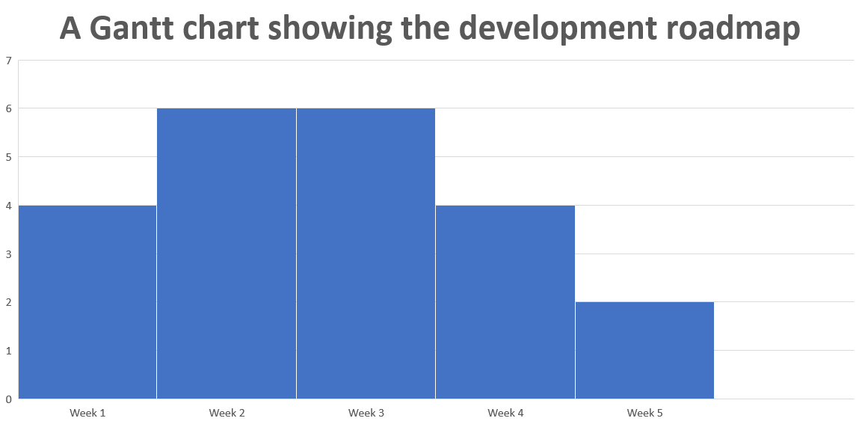

Slide 14
Conclusion
Summary: The DIMSVERLENPEL MVP will validate the platform's core value proposition, gather feedback from early users, and demonstrate its potential for cross-chain collateralization and liquidation.
Call to action: Join the DIMSVERLENPEL community to stay updated on the MVP development and provide feedback.

